Slide 1

Basic Details of the Team and Problem Statement
Ministry : National Disaster Response Force (NDRF)
PS Code: GS 902
Problem Statement Title: Effective Under Water Search/ROV
Team Name: Super 6
Team Leader Name: Maaz Shahid
Institute Code: C-6198
Institute Name: Techno International New Town
Theme Name: Disaster Management

Slide 2
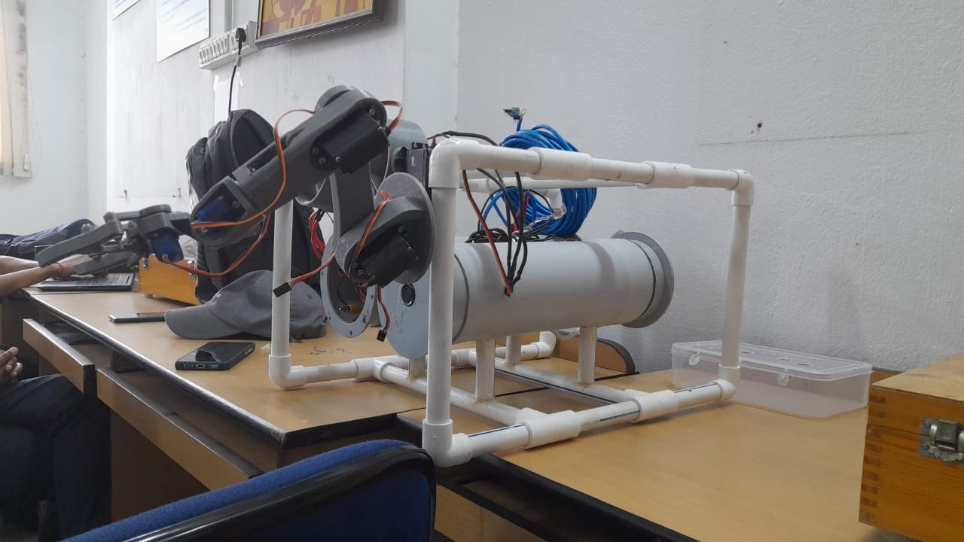
Idea/Approach Details
Describe your idea/Solution/Prototype here:
We have tried to make an underwater ROV(Remotely Operated Vehicle) fixed with advanced sensors and software to assist NDRF and divers while carrying out the search operations using readily available materials in order to make it cost-effective and easily repairable. The ROV contains a self-contained and integrated system. It is a buoyant and ballast system and has the ability to detect objects, create a 3D point cloud map and using AI provide a clear view to the spectators involved . The robotic arm attached with the ROV makes it ideal to move or retrieve any object if necessary. The ROV can be used in scientific research, underwater archaeology and oil drilling supports.
Describe your Technology stack here:
2x 12V 3S 2500 mAh Samsung INR18650 25R Li-ion battery
3x Brushless motor
3x Brushless Electronic Speed Controller
3x MG90 servo
6x MG995 servo
1x Arduino Nano
1x Arduino UNO
1x 640px420p camera
1x JSN-SR04T Ultrasonic sensor
1x 16ch PCA9685 servo board
2x MAX485 TTL to RS485 conversion module

Slide 3
Idea/Approach Details
Describe your Use Cases here
Describe your Dependencies / Show stopper here
ROVs are often used in search and rescue operations to find missing objects , humans , boats , ships, etc.
ROVs are used for different underwater works. Like, large ROVs are used in offshore oil and gas industries and small ROVs are used in water tank inspection, pipe inspection, wastewater treatment inspection, commercial diving, etc.
ROVs are used by different research institutes to study ocean from its coastal shallows to greatest depths.
ROVs are widely used in STEM(science, technology, engineering and mathematics) education and in different academic research works.
Object Size Detection using Machine Learning
Accurate measurement using LIDAR and Ultrasonic sensor
Operation depth range of up to 30m
Viscous drag resistant design
Highly maneuverable
Long battery life with external power option
Easy to assemble and repair
Robust communication system

Slide 4
Team Member Details
Team Leader Name: Maaz Shahid
Branch (Btech) Stream (CSE) Year (II)
Team Member 1 Name: Pratham Choudhary
Branch (Btech) Stream (CSE) Year (II)
Team Member 2 Name: Pradyumn Choudhary
Branch (Btech) Stream (CSBS) Year (II)
Team Member 3 Name: Swarnadeep Karmakar
Branch (Btech) Stream (CSE) Year (II)
Team Member 4 Name: Baisali Roy
Branch (Btech) Stream (CSE) Year (II)
Team Member 5 Name: Akash Kotal
Branch (Btech) Stream (CSE) Year (II)
Team Mentor 1 Name: Nilanjana Adhikari
Category (Academic/faculty) Expertise (NLP/ML) Domain Experience: 14 Years

